Slide 1
Hackathon Project
Team -2
(QEA21QE032) Hackathon project

Slide 2
Team Members
S Dhanusrri - 2068142
Poorna Venkataraman - 2068052
Naga Lakshmi K - 2068531
S Anand - 2068483
Hariharan B - 2068153

Slide 3
Project Title : Identify Car Wash Services
Display 5 Car washing services name and phone numbers 1. Car washing services near you with highest rating on top. 2. Rating should be more than 4* 3. Customer Votes should be more than 20 (Suggested Site: justdial.com however you are free to choose any other legitimate site)

Slide 4
Detailed Description
1. Display 5 Car washing services name and phone numbers, near your location with highest rating (more than 4) on top & Customer Votes more than 20 2. Try to register for Free Listing, fill the form with any one input invalid (example: phone); Capture the error message & display 3. From Fitness, go to Gym and retrieve all sub-menu items and store in a List; Display the same (Suggested Site: justdial.com however you are free to choose any other legitimate site)

Slide 5
Website used:
https://www.justdial.com/
Tools/Software's Used:
Selenium – Portable Framework for testing Web Applications and automating the process.
Java – High level Programming Language.
Eclipse – Integrated Development Environment for various ‘Languages’.
TestNG – Open source testing framework.
Maven – Software and project Management Tool.
Apache POI – Excel Report.

Slide 6
Work Done
The code is written in JAVA language and then is further automated using Selenium.
Data obtained from website is stored in Excel Sheet using Apache POI; also, data input is taken from a file with variables written in it.

Slide 7
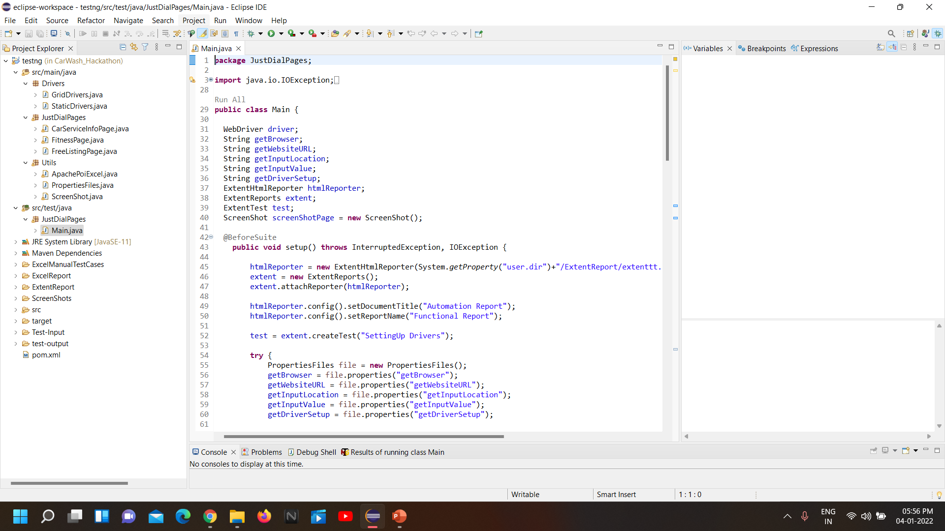
Project Structure

Slide 8
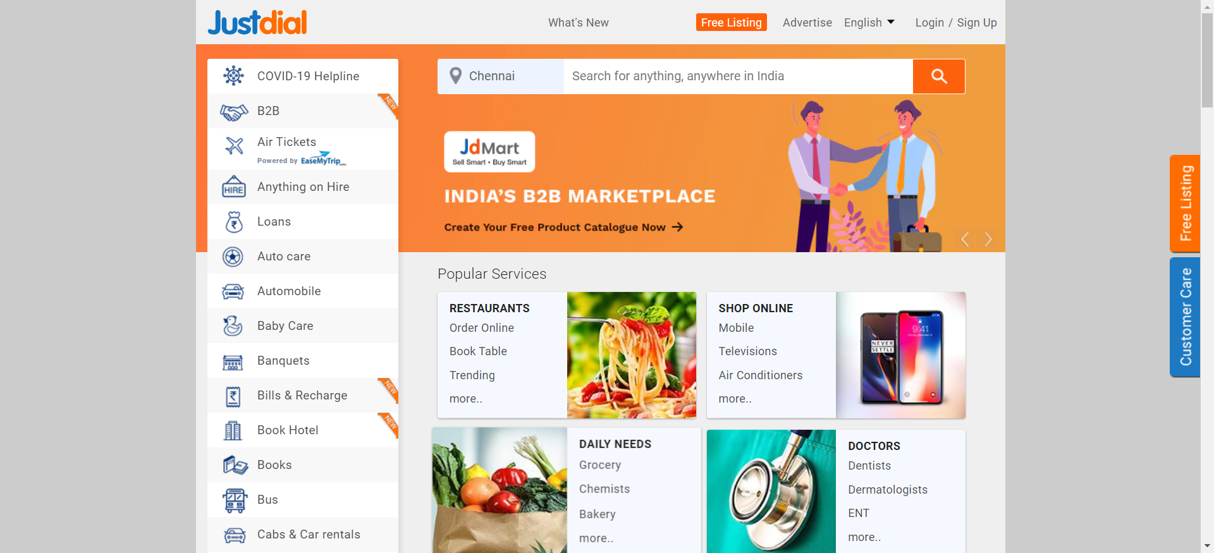
Real Time Screenshot

Slide 9
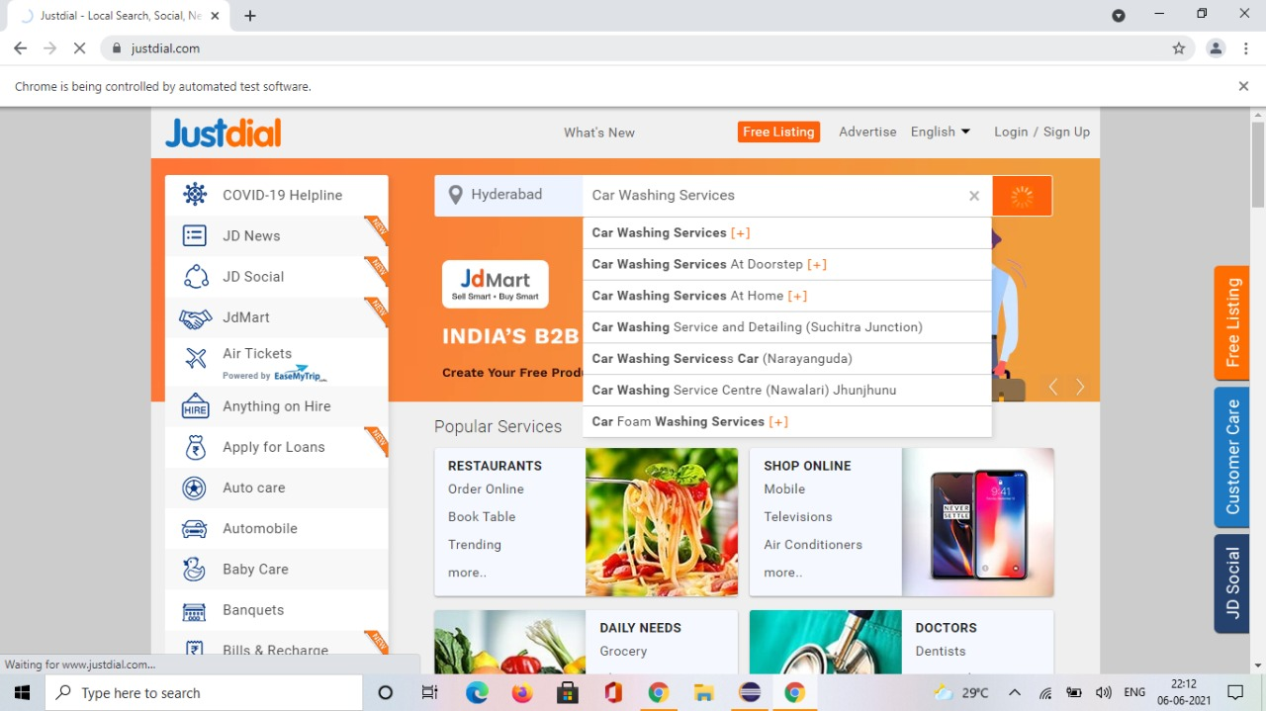
Real Time Screenshot

Slide 10
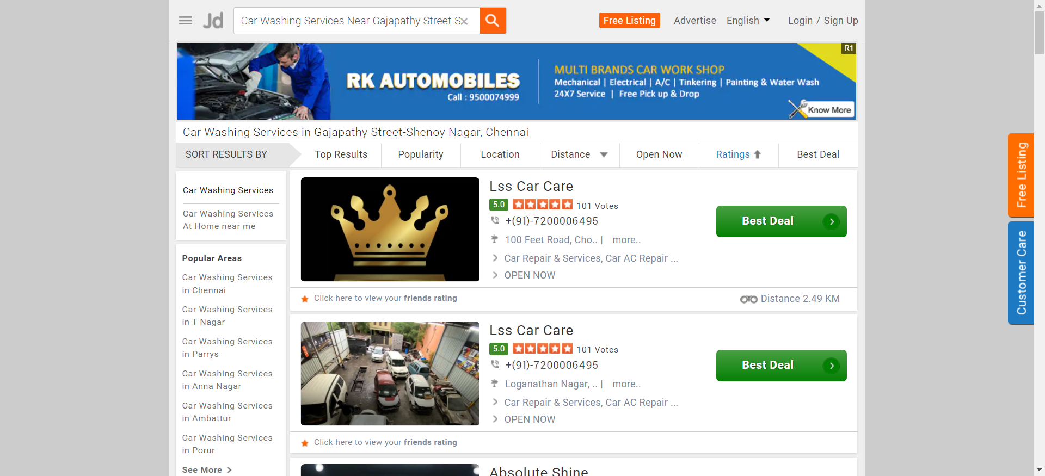
Real Time Screenshot

Slide 11
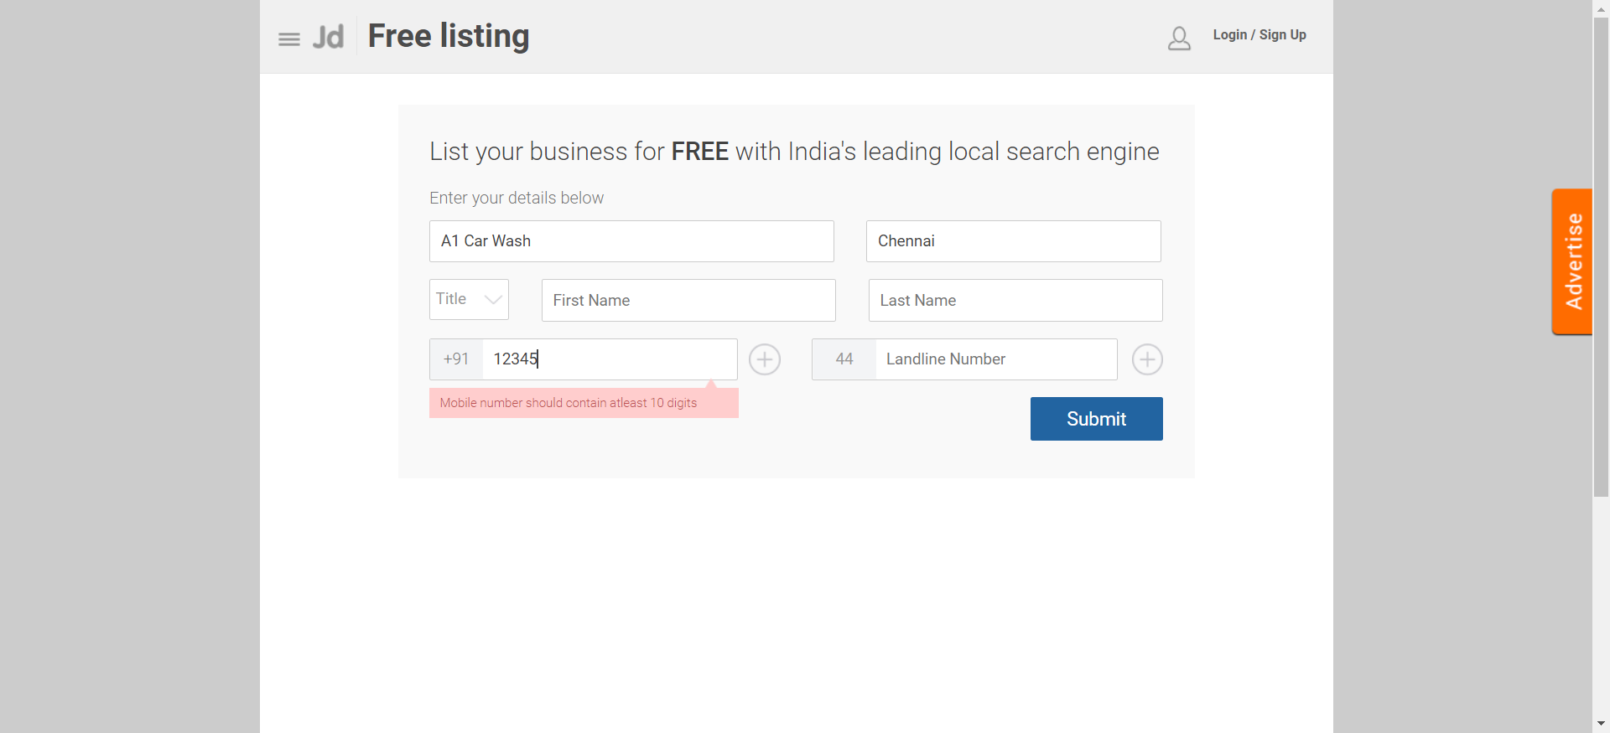
Real Time Screenshot

Slide 12
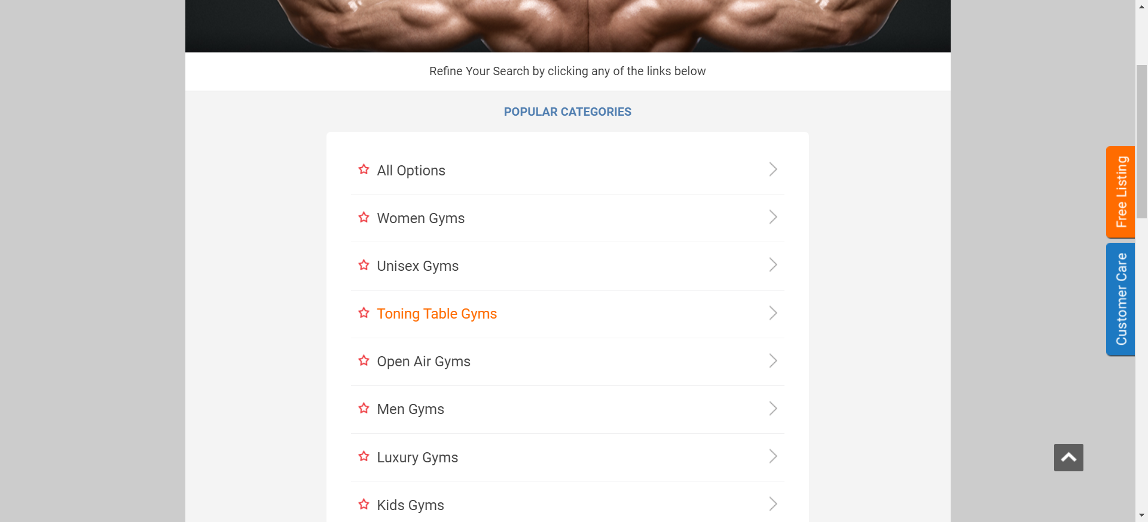
Real Time Screenshot

Slide 13
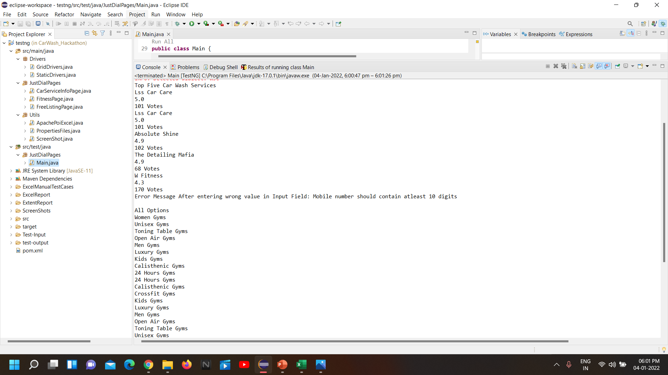
Saved Output Screenshot
MAVEN

Slide 14
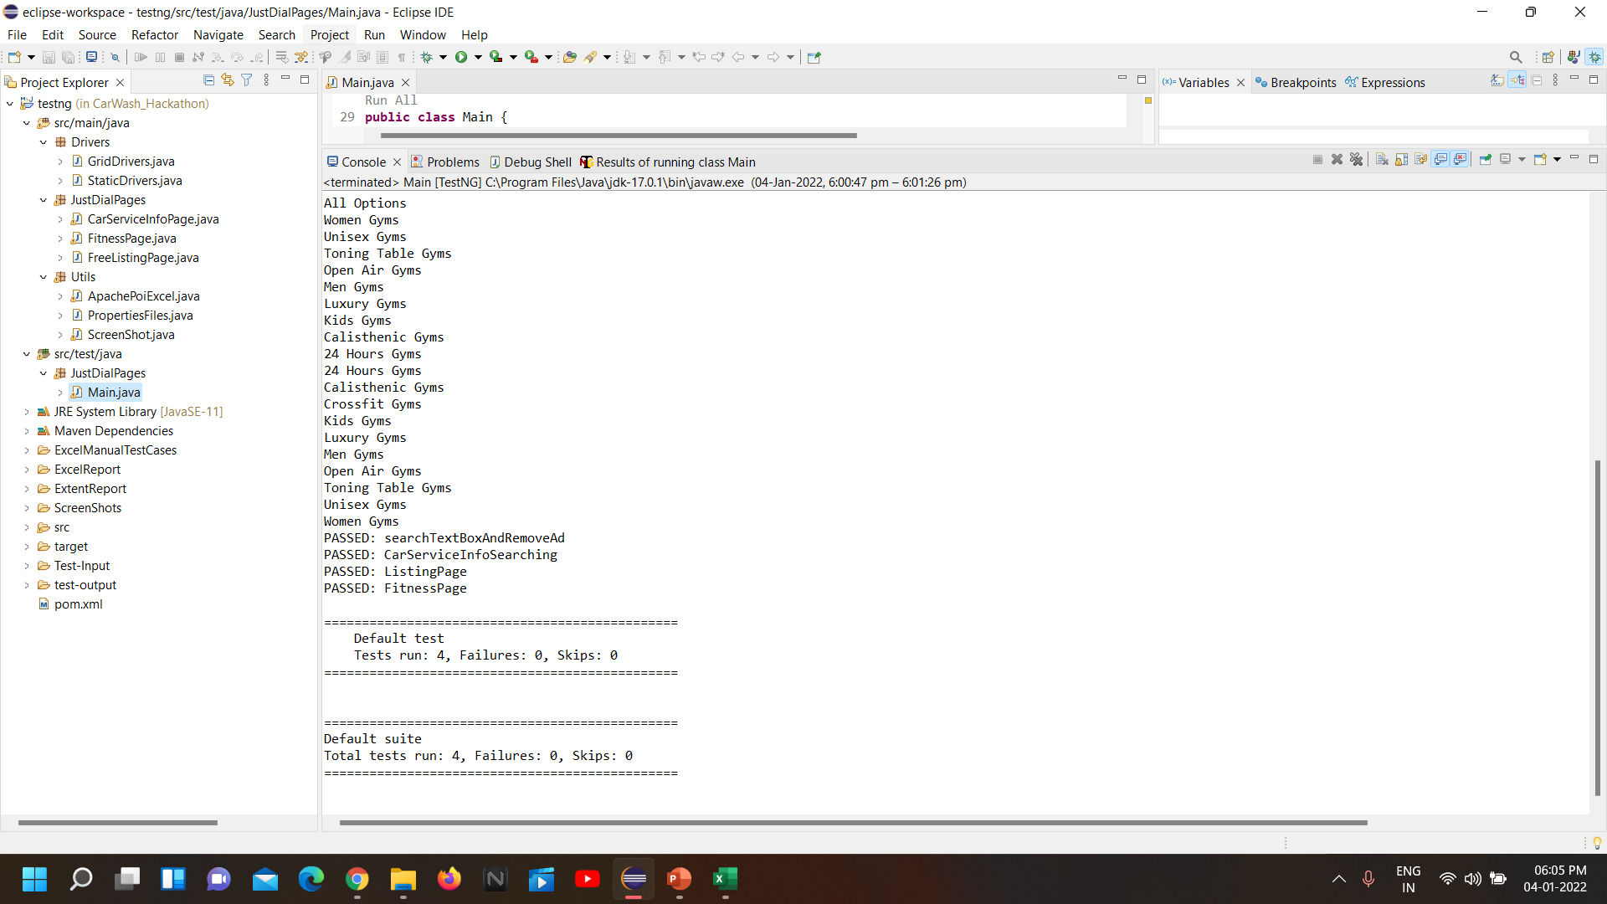
Saved Output Screenshot

Slide 15
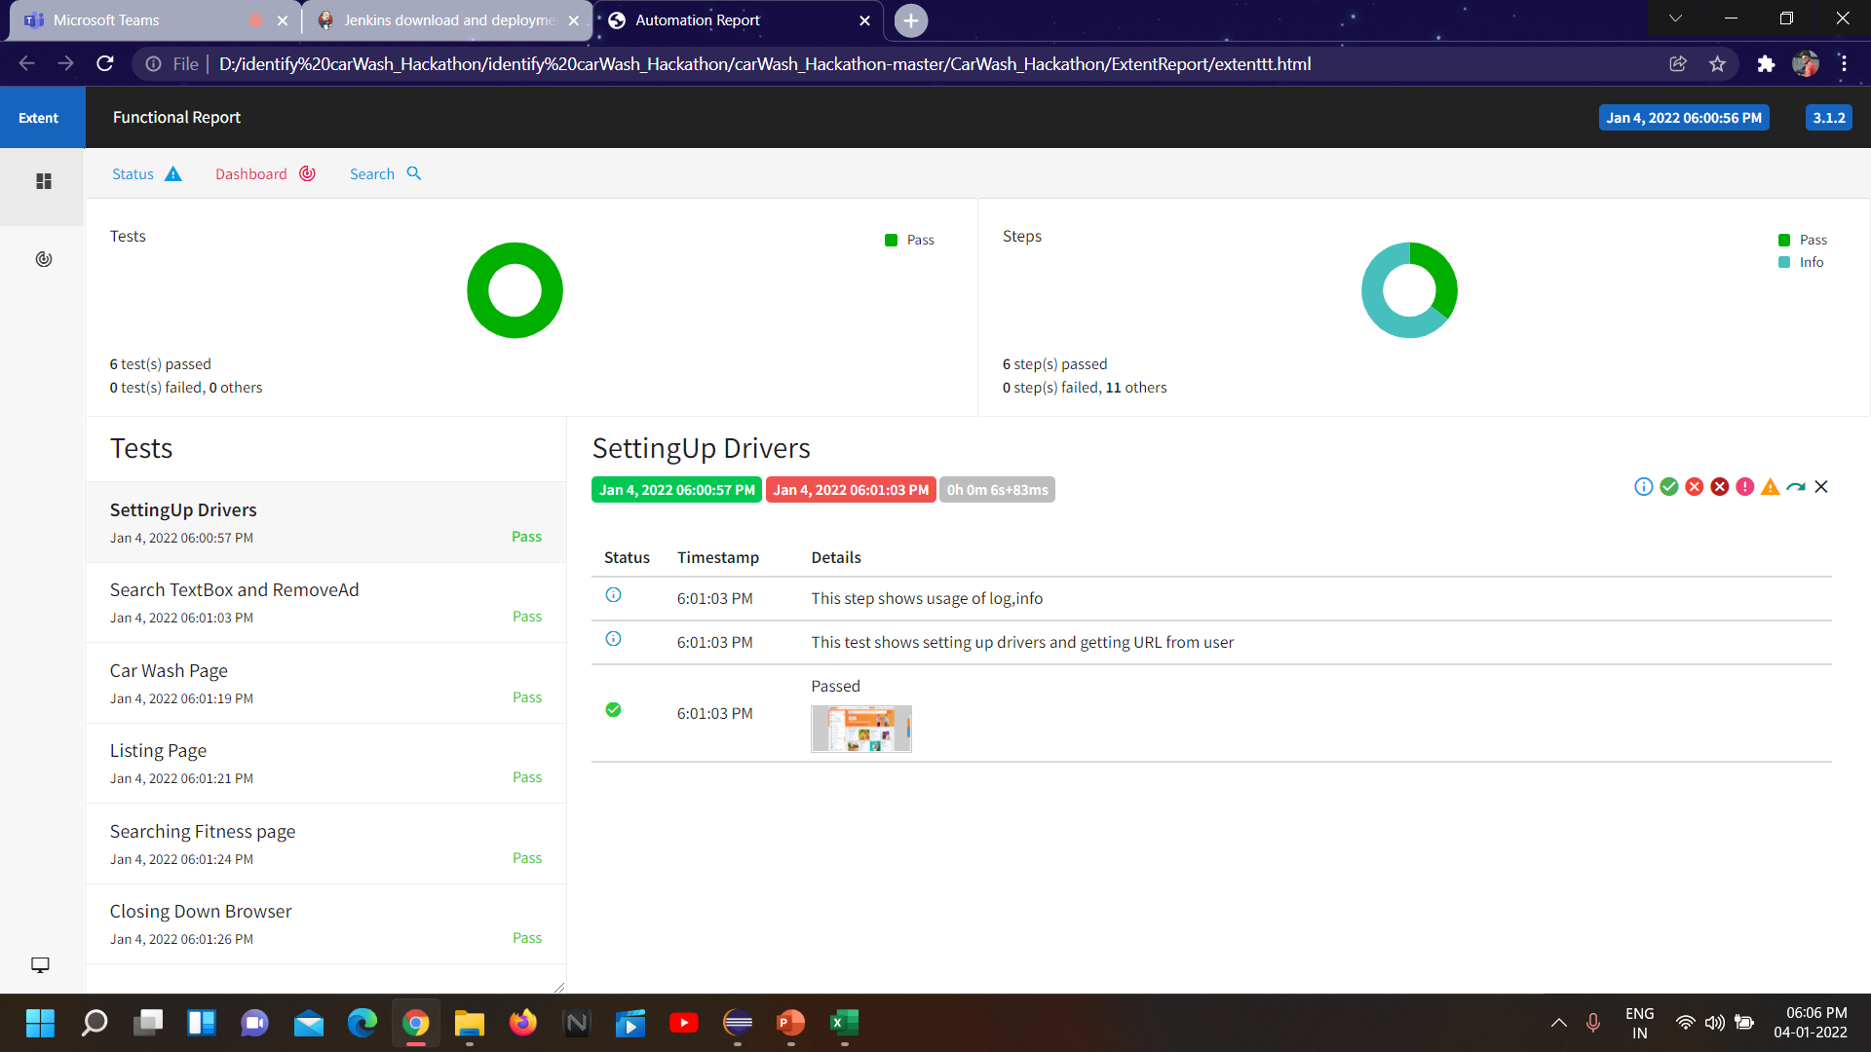
Extent Report

Slide 16
THANK YOU

